Slide 1
Measuring a model: accuracy, precision, recall, F1, ROC and AUC, thresholds, baselines, overfitting
How do I know whether a model is any good, and what should I ask the vendor who says it is?
Applied AI and Automation | Session 3 of 14
KLAi Professional Learning | Jotham Martin Wambi
Notes:
Last time you saw how a model learns from examples. Today we ask the question every buyer should ask next: how good is it?
Session 0 gave you the vocabulary. Today you see it work on a real result table, you move a threshold yourself, and you meet a model that scores ninety percent by doing nothing.
The question for today is this: How do I know whether a model is any good, and what should I ask the vendor who says it is? Keep it in mind. At the end of the session we come back to it and see how much more you can say.

Slide 2



Today in one view: what you will leave with
By the end of today you will have
Read a result table: accuracy, precision, recall, F1 and what moving the threshold does
Spot a model that only looks good: the always-say-no score, a missing baseline, a memorised answer
Take away a list of questions to put to any vendor about the numbers
Notes:
By the end of today you can read a result table with some confidence. You will spot three ways a model looks good without being good. And you leave with a one-page question sheet that you can put to any vendor, about the numbers behind their claim. There are no tests today. We use pencil and paper in the second half.

Slide 3
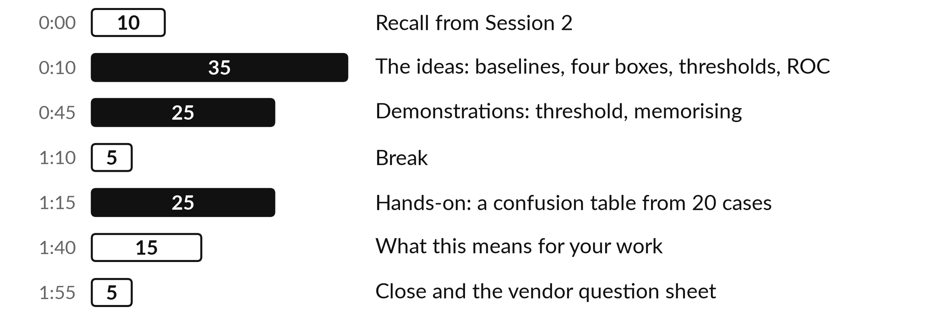
Your two hours: a real result
table, then your own pencil work
Most of the numbers today come from a run I record in advance. You can ask me to rerun it live.
Notes:
We spend the first part on the ideas behind a result table: baselines, the four boxes, precision and recall, thresholds and the ROC curve. Then I run two demonstrations on a made-up late-payment model for Nile Valley Foods, and I move the threshold while you watch the numbers change.
After the break you work with a pencil on twenty cases and fill in a confusion table by hand. We finish with the question sheet you can put to any vendor.

Slide 4

Three questions from last time
1. What is the difference between supervised and unsupervised learning?
2. How does a decision tree reach its answer?
3. How does a nearest-neighbours model decide?
Answer aloud first. Then we check together.
Notes:
Three quick questions from Session 2. Answer aloud first, and then we check together. It is a warm-up to bring last time back.
Question one. What is the difference between supervised and unsupervised learning? Take a moment.
A good answer is this. Supervised learning uses examples with the right answer attached, such as invoices marked late or on time. Unsupervised learning is given no answers and finds groups.
Question two. How does a decision tree reach its answer? Say it to yourself first.
A good answer is this. It asks a chain of yes or no questions about the case, from the top down, until it reaches a leaf that gives the answer. The questions come from the training data.
Question three. How does a nearest-neighbours model decide? Think about your own task as you answer.
A good answer is this. It finds the past cases most like the new one and gives the answer most of them had.
If an answer was missing, your own task card or last workbook page has it. Now to today.

Slide 5




Words we use today
Word | What it means
Baseline | A simple way of doing the task that a model must beat, such as always saying no.
Threshold | The score above which the model raises an alert. You choose it.
Precision | Of the cases the model flagged, the share that really were the thing.
Recall | Of the real cases, the share the model flagged.
AUC | One number for how well a model ranks real cases above the rest, at every threshold.
Notes:
Five words for today. I give the plain meaning of each, and we use every one of them before the end of the session.
Baseline. A simple way of doing the task that a model must beat, such as always saying no.
Threshold. The score above which the model raises an alert. You choose it.
Precision. Of the cases the model flagged, the share that really were the thing.
Recall. Of the real cases, the share the model flagged.
AUC. One number for how well a model ranks real cases above the rest, at every threshold.

Slide 6
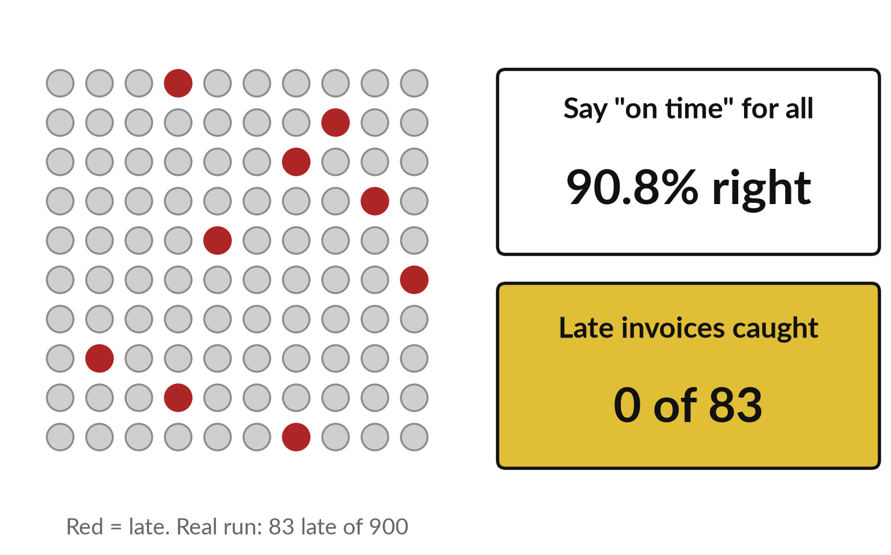
A model that says "on time" every
time is right 91 times in 100
Most invoices are paid on time, so doing nothing looks excellent.
In our test, 83 of 900 invoices were late.
Always saying on time is right 817 times: 90.8%.
It catches no late invoice at all.
Notes:
Start with a trick that fools many buyers. Imagine a model that looks at an invoice and says, on time, every single time. Out of nine hundred test invoices from our made-up Nile Valley Foods data, eighty-three were paid late and eight hundred and seventeen were on time.
So this lazy model is right eight hundred and seventeen times, which is ninety point eight percent. It sounds excellent. And it has caught not one late invoice. When something is rare, accuracy rewards doing nothing. What is rare in your business, and would a high accuracy figure tell you anything about it?

Slide 7
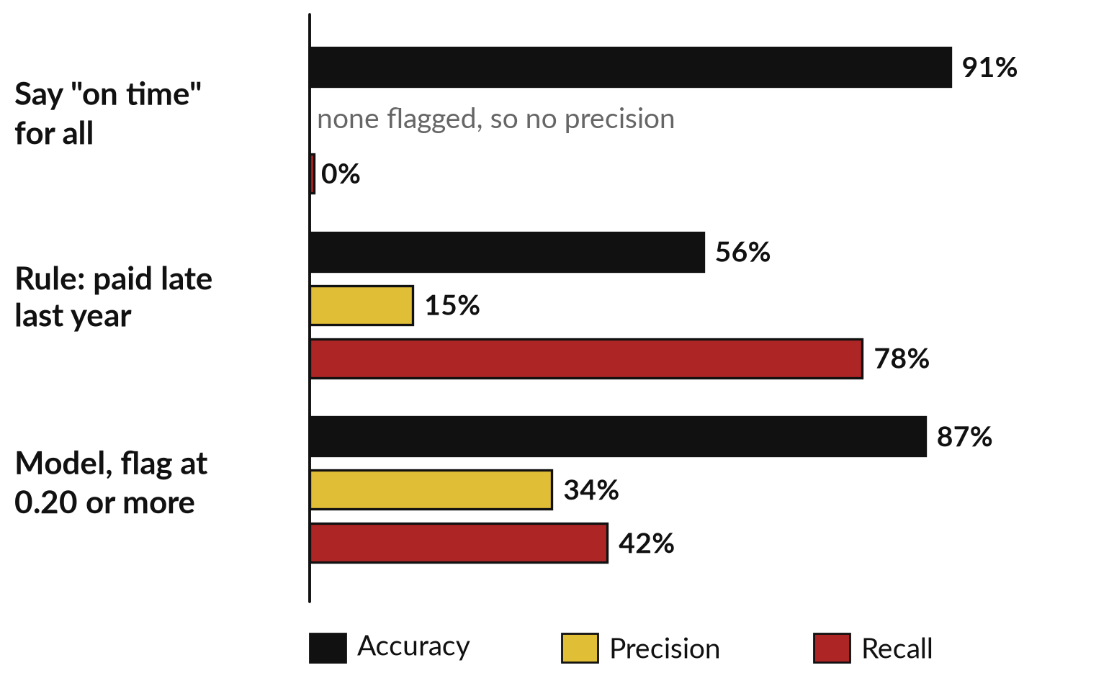
A baseline is the score a model
must beat before it earns a place
Compare the model with the simplest sensible alternatives.
Say on time for all: accuracy 91%, recall 0%.
A plain rule, paid late last year: recall 78%.
Model against rule: precision 34% against 15%, recall 42% against 78%.
Notes:
A baseline is the simplest sensible way of doing the task. There are two here. The first is always say on time. The second is a plain rule a clerk could write: flag any shop that paid late at least once last year. That rule catches seventy-eight percent of the late invoices, but it flags four hundred and forty-five invoices to find sixty-five, so only fifteen percent of its flags are right.
Our model at a threshold of zero point two catches forty-two percent, with thirty-four percent of its flags right. The model must beat these baselines at a price you can afford. If a vendor shows no baseline, ask for one. This chart is a recorded run.

Slide 8
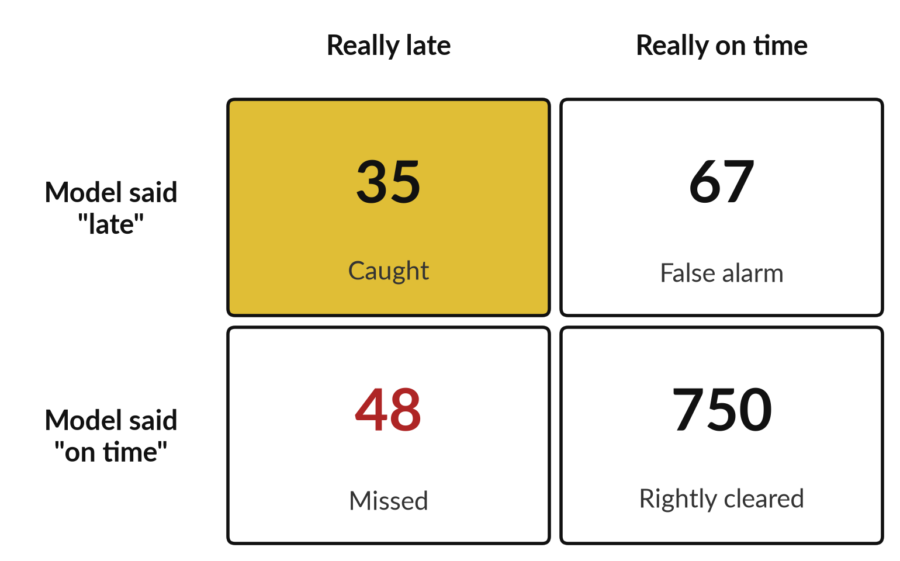
Four boxes hold every answer a
model gives, and each box has a cost
This is the confusion table from our real run, flagging at a score of 0.20.
Precision is caught ÷ flagged: 35 ÷ 102 = 34%.
Recall is caught ÷ really late: 35 ÷ 83 = 42%.
The 48 missed invoices are the costly ones.
Notes:
Session 0 introduced the four boxes. Here they hold real numbers. The model flagged a hundred and two invoices as probably late. Thirty-five really were late: those are caught. Sixty-seven were false alarms. Forty-eight late invoices were missed, and seven hundred and fifty on-time invoices were rightly left alone.
Now two calculations by hand. Precision is caught divided by flagged: thirty-five over a hundred and two, thirty-four percent. Recall is caught divided by really late: thirty-five over eighty-three, forty-two percent. Which box would hurt your business most, the false alarms or the missed cases?

Slide 9
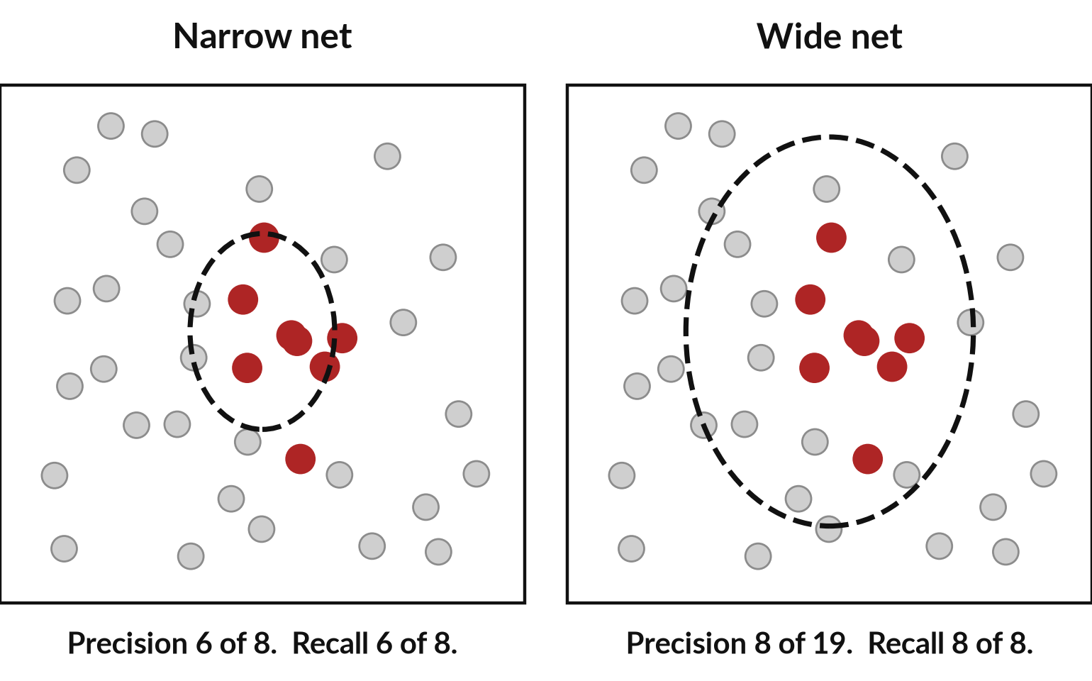
Precision and recall are two different
questions, like a narrow net and a wide net
A fisher with a wide net catches more fish and more rubbish.
Narrow net: few flags, mostly right, some real cases missed.
Wide net: every real case caught, many false alarms.
Drawing for illustration, not our data.
Notes:
Here is a picture to hold both ideas. Think of a fisher. A narrow net catches few fish, and most of what is in it is the fish you want. That is high precision. But many fish swim past, so recall is lower. A wide net catches nearly every fish you want, which is high recall, and it also brings in a lot of rubbish, so precision falls.
The red dots are the cases you care about. This drawing is an illustration with forty dots, not our real data. Every model sits somewhere between the narrow net and the wide net, and you decide where. Which would you want for a fraud alert?

Slide 10
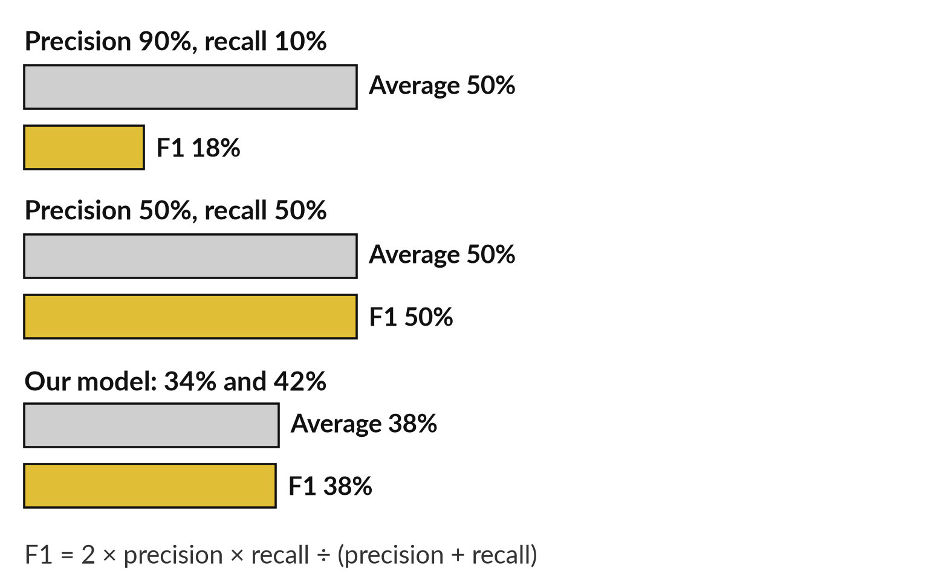
F1 gives one number, and
it punishes a lopsided pair
Average the two and a lopsided model still looks fair. F1 does not.
Precision 90% and recall 10% averages 50%.
F1 for that pair is 18%.
The real term: F1, the harmonic mean.
Notes:
Sometimes you want a single number for precision and recall together. The plain average is misleading. A model with ninety percent precision and ten percent recall averages fifty percent, which sounds middling, yet it misses nine of every ten real cases. F1 uses a different kind of average, called the harmonic mean, that stays close to the weaker of the two.
For that lopsided pair, F1 is eighteen percent. For our model, precision thirty-four and recall forty-two, F1 is thirty-eight. The formula is on the slide: two times precision times recall, divided by their sum. F1 is handy for comparing, but it hides what each mistake costs.

Slide 11
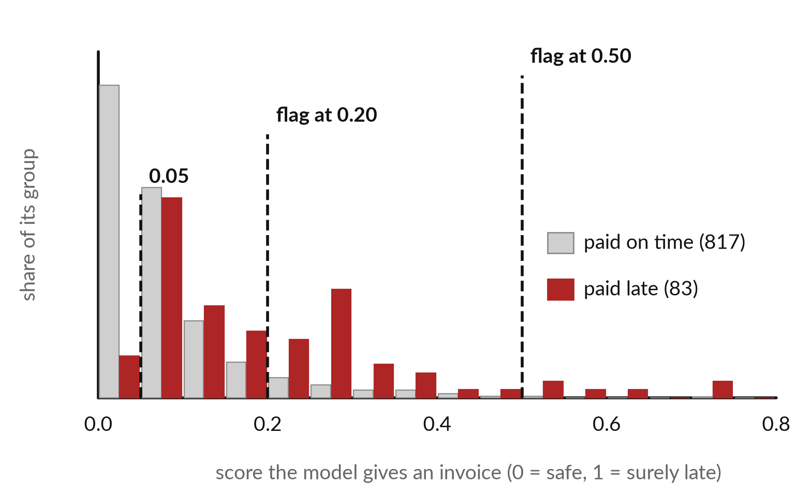
The model gives a score, and you choose
the line above which it raises an alert
Late invoices tend to score higher, but the two groups overlap.
The line is the threshold.
Move it right: fewer flags, fewer false alarms, more misses.
Move it left: the reverse.
Notes:
Most models do not say late or on time. They give each invoice a score, and you pick a line, called the threshold. Above the line the model raises an alert. This picture shows our real scores for the nine hundred test invoices. Grey bars are invoices paid on time, red bars are invoices paid late.
Late invoices tend to score higher, but the groups overlap, so no line is perfect. Move the line to the right and you flag fewer invoices, with fewer false alarms and more misses. Move it left and you flag more, catch more, and raise more false alarms. The threshold is a business decision.

Slide 12
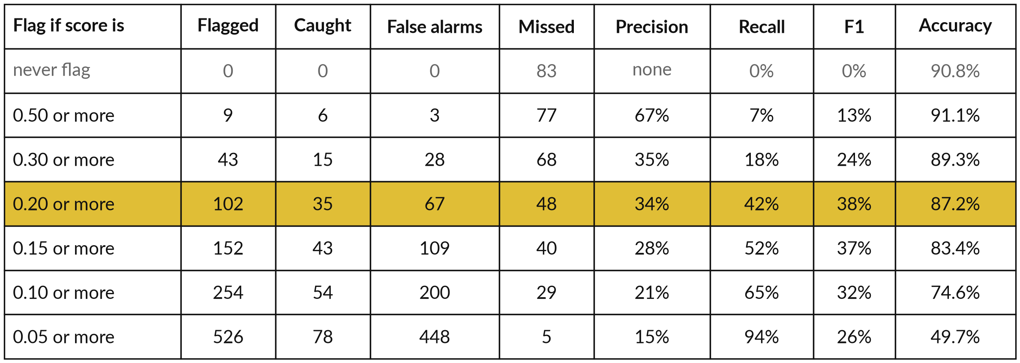
The same model at six thresholds: recall
climbs while precision and accuracy fall
Recorded run, 6 November 2026, scikit-learn: 900 test invoices, 83 late. Top row: the lazy model.
Notes:
This is the result table from the recorded run, and it is the one to study. Each row is the same model with a different threshold. At zero point five the model flags only nine invoices, catches six, and misses seventy-seven. At zero point zero five it flags five hundred and twenty-six, and misses only five.
Look down the recall column: seven, eighteen, forty-two, fifty-two, sixty-five, ninety-four percent. Now look at accuracy. It falls from ninety-one to fifty percent, which is worse than the lazy model in the top row. A vendor who quotes only accuracy chooses the row that flatters them.

Slide 13
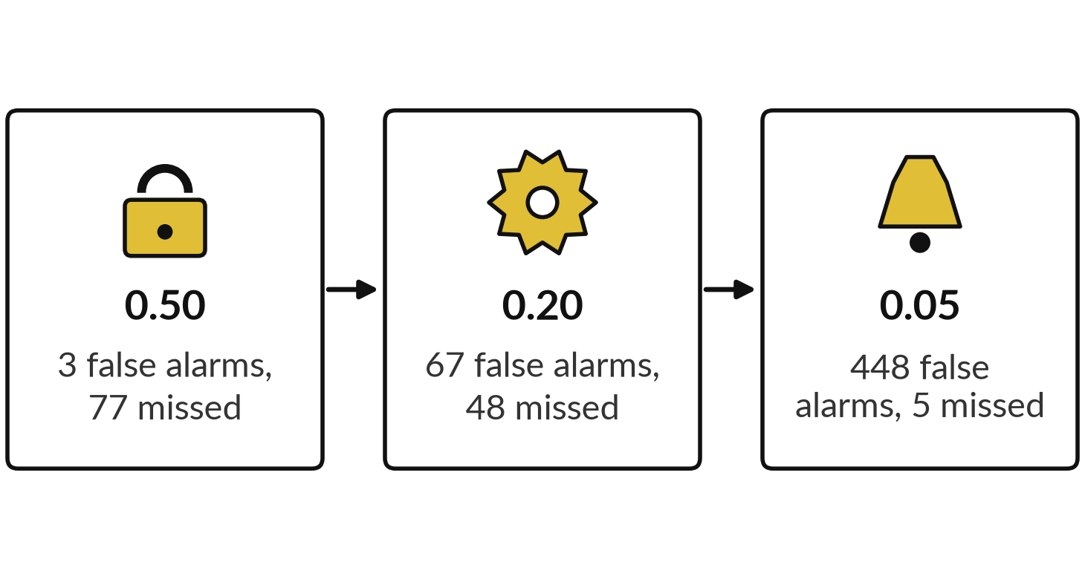
Demonstration 1: move the
threshold and read the row
I will show
Watch for
Recall climbs, precision falls.
Accuracy gets worse while recall improves.
The cheapest row depends on the costs.
Notes:
Now I run this live. I open a terminal and type the threshold script with three values, zero point five, zero point two and zero point zero five. It rebuilds the same made-up dataset and the same model every time, because the random seeds are fixed, so you should see the numbers from the table.
Watch three things. Recall climbs as the threshold falls. Precision falls. And accuracy gets worse while recall improves. I will also change the cost figures and run again, so you can see that the best row changes with what a mistake costs. If you want a value tried, tell me and I will type it.

Slide 14
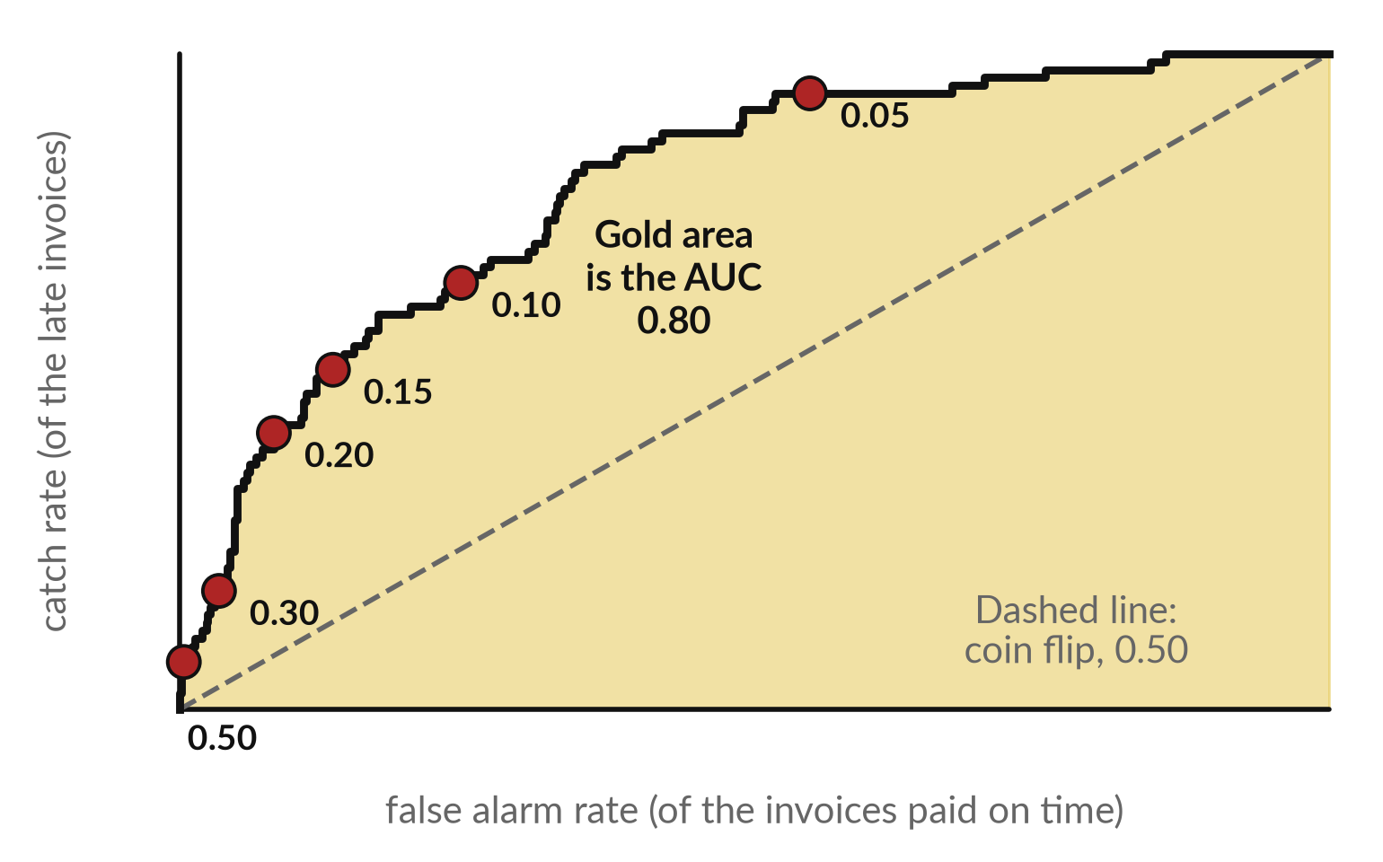
The ROC curve shows every threshold at
once, and AUC sums it up in one number
Each dot is one threshold. The higher the curve above the dashed line, the better.
At 0.20: catch 35 of 83 (42%), false alarms 67 of 817 (8%).
AUC 0.80: pick one late and one on-time invoice, and 80 times in 100 the late one scores higher.
Notes:
The ROC curve takes the table you just saw and draws every threshold on one picture. Along the bottom is the false alarm rate: of the invoices paid on time, what share did we flag. Up the side is the catch rate: of the late invoices, what share did we catch.
At a threshold of zero point two the point sits at forty-two percent caught and eight percent false alarms. The dashed line is a coin flip. The area under the curve is the AUC, here zero point eight. There is a plain meaning: pick one late and one on-time invoice at random, and about eighty times in a hundred the model gives the late one the higher score. AUC does not choose your threshold for you.

Slide 15
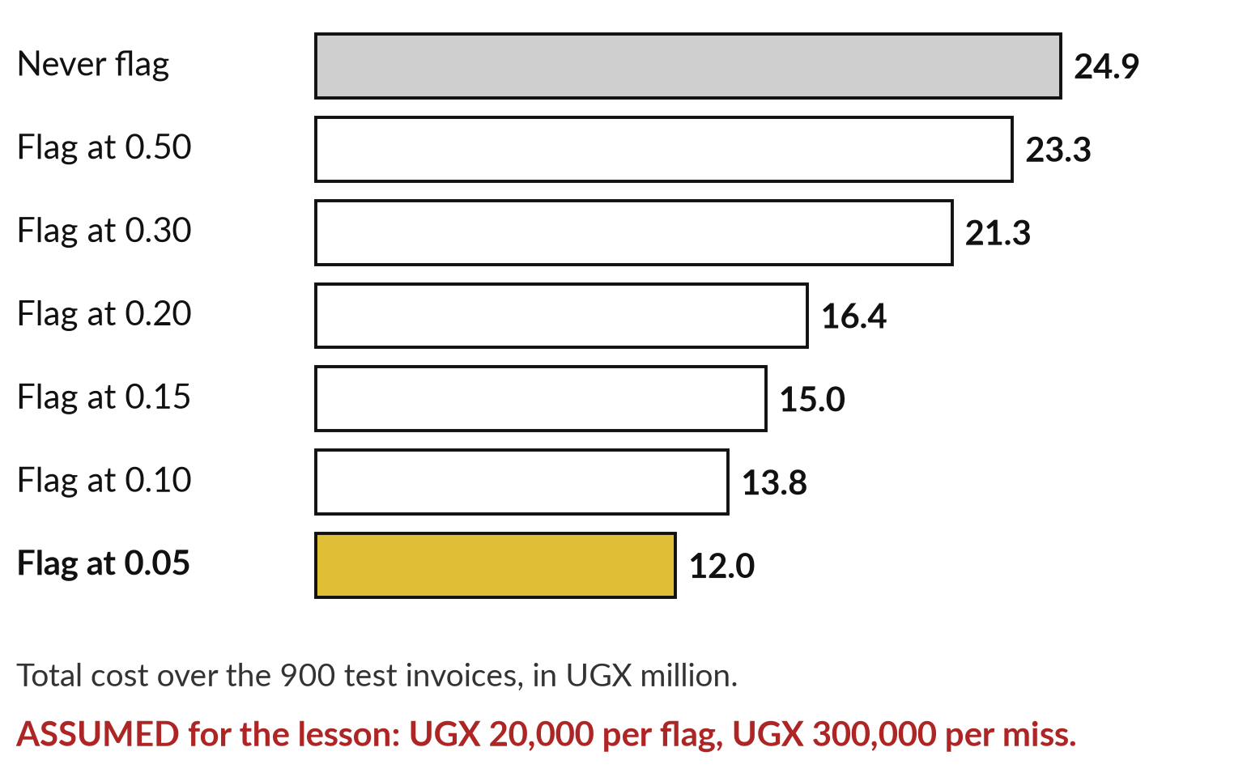
Choose the threshold with money: the best
line depends on what each mistake costs
Assumed costs for the lesson: UGX 20,000 per flag, UGX 300,000 per miss. Use your own.
At 0.20: 102 flags × UGX 20,000 = UGX 2.04 million.
Plus 48 misses × UGX 300,000 = UGX 14.4 million.
Total UGX 16.44 million. Change the costs and the best row changes.
Notes:
This is where a finance manager feels at home. Suppose chasing a flagged invoice costs UGX 20,000 of staff time, and a missed late invoice costs UGX 300,000 in tied-up cash and follow-up. Those two figures are only my assumption for the lesson, and you would use your own.
At a threshold of zero point two the cost is a hundred and two flags times UGX 20,000, which is UGX 2.04 million, plus forty-eight misses times UGX 300,000, which is UGX 14.4 million. Total: UGX 16.44 million. The lazy model costs UGX 24.9 million. With these costs the cheapest row is the widest net. Change the costs and the answer changes.

Slide 16
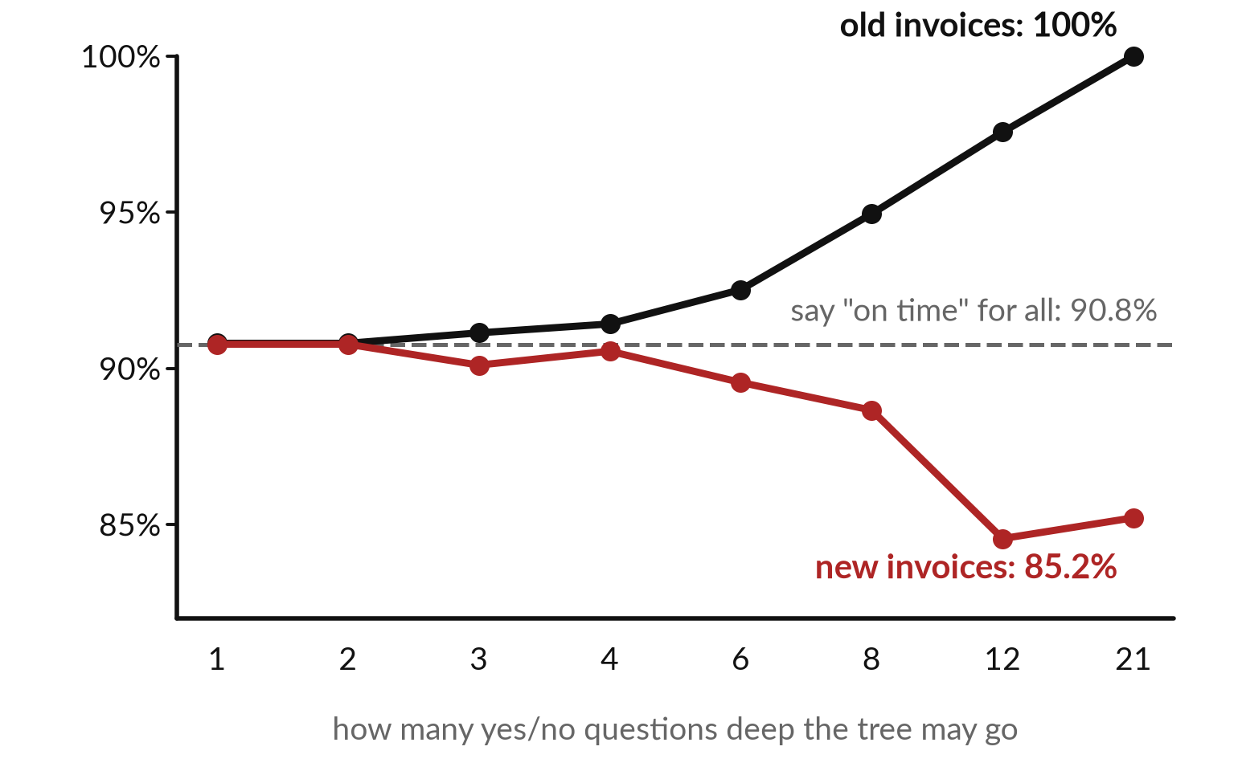
A model can memorise: the deeper the tree,
the better on old data and the worse on new
A shopkeeper who remembers every past sale by heart still cannot price a new customer.
An unlimited tree scored 100% on the 2,100 invoices it studied.
On 900 new ones it scored 85.2%, worse than the lazy 90.8%.
The real term: overfitting.
Notes:
Session 0 warned you that a model can memorise. Here it is on real numbers. We trained decision trees, the kind you met last time, with different depths. A depth is how many yes or no questions the tree may chain together. The black line is the score on the two thousand one hundred invoices the tree studied.
It climbs to a hundred percent, because a deep tree can memorise each invoice. The red line is the score on nine hundred invoices it never saw. It falls to eighty-five point two percent, below the lazy model at ninety point eight. High accuracy on old data tells you nothing. This is overfitting.

Slide 17
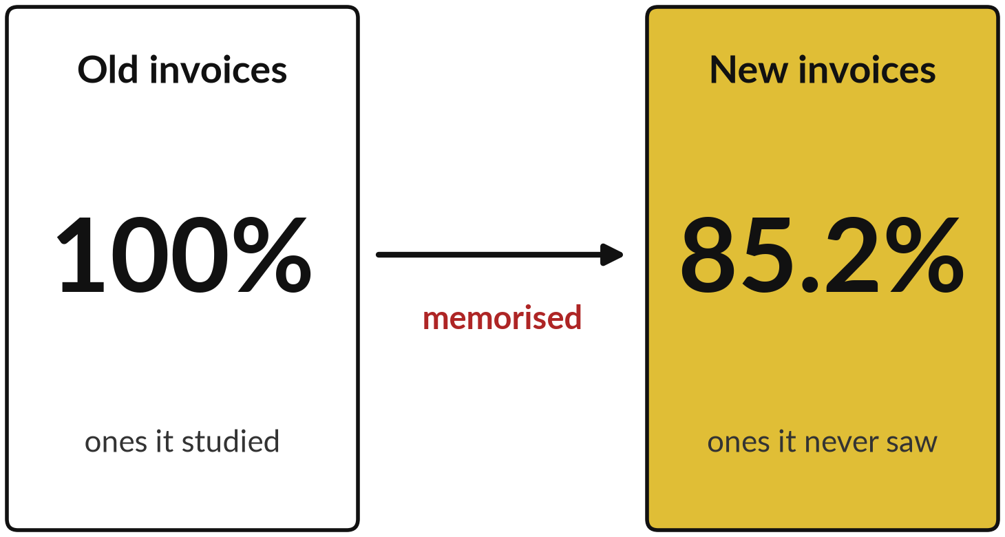
Demonstration 2: a deep tree
memorises, and a baseline shows it
I will show
Watch for
Training accuracy 100%, test accuracy 85.2%.
The lazy baseline scores 90.8%.
A small tree, depth 3: 91.1% old, 90.1% new.
Notes:
The second demonstration. I run the measuring script from the demo folder. It prints the baselines, the threshold table and the trees. Look for the deep tree: twenty-one questions deep, two hundred and twenty-nine leaves, a hundred percent on the invoices it studied. Then look at the test score, eighty-five point two.
Next to it, the baseline that always says on time scores ninety point eight. A small tree, three questions deep, scores ninety-one percent on old invoices and ninety on new ones, which is honest but no better than doing nothing. The lesson: ask for the score on data the model never saw, and for the baseline beside it.

Slide 18






Which mistake costs more depends on the job
Area | The model flags | A miss costs | A false alarm costs
Finance | Invoices likely paid late | Cash tied up for weeks | A phone call
Compliance | Suspicious payments | A fine or a lost licence | An analyst hour
Customer service | Customers about to leave | A lost shop | An unneeded priority call
HR | CVs to shortlist | A strong candidate lost | Interview time wasted
Operations | Trucks likely to break | A day of deliveries lost | An early service
Legal | Privileged documents | One handed over by mistake | A lawyer reads one more
Equal costs are rare. Say which mistake hurts more before you choose a threshold.
Notes:
The same two mistakes cost different amounts in different jobs. In finance, a missed late invoice ties up cash, while a false alarm costs a phone call. In compliance, a missed suspicious payment can cost a fine, and a false alarm costs an analyst an hour. In customer service, a missed unhappy customer can be a lost shop.
In HR, a missed strong candidate is a loss you never see. In operations, a missed breakdown costs a day of deliveries. In legal work, a privileged document handed over by mistake is serious, while a lawyer reading one extra costs minutes. In most of these, a miss costs more.
Which row is closest to your work?

Slide 19
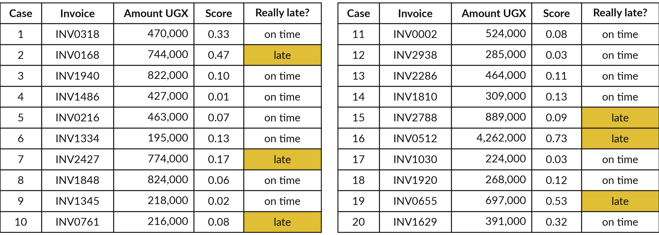
Twenty real cases from the test set: the
model flags a case at a score of 0.20 or more
Drawn from the recorded run. Gold shows the invoices that really were paid late.
Notes:
This is your exercise sheet. It lists twenty invoices drawn from the real test set of the recorded run. For each one you see the invoice number, the amount, the score the model gave it, and whether it really was paid late, shown in gold. Six of the twenty were late.
The rule for the model is simple: a score of zero point two or more means flagged. Read down the list once before you start, and notice that some late invoices score very low. That is what a miss looks like. In a moment you will fill in the four boxes and work out precision and recall with a pencil.

Slide 20
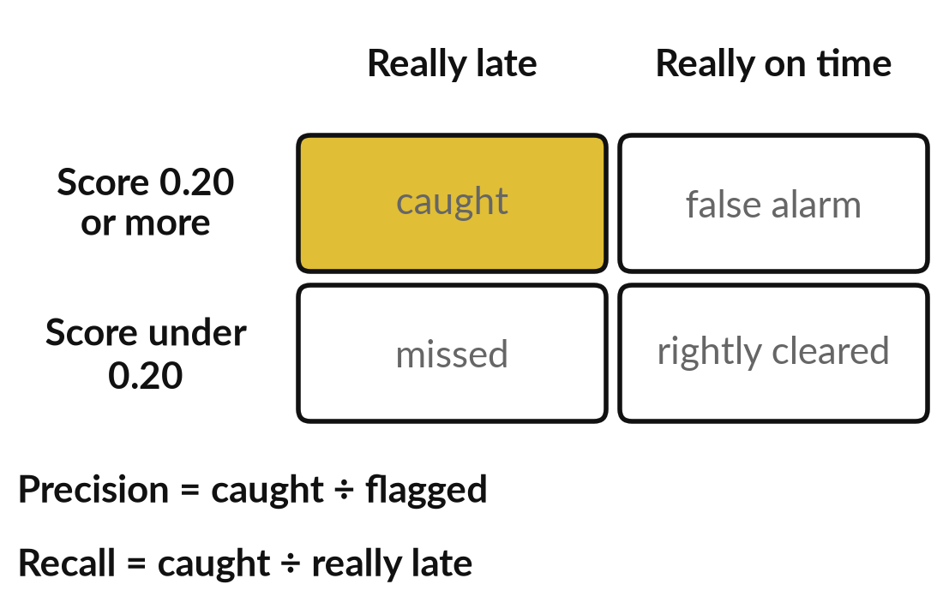
Fill the four boxes from the twenty
cases, then work out precision and recall
20 minutes
Hands-on, no computer
Count the twenty cases into four boxes.
Flag every case with a score of 0.20 or more.
Count caught, false alarms, missed and rightly cleared. They add to 20.
Precision: caught ÷ flagged.
Recall: caught ÷ really late.
You keep: The filled table and two percentages. The worksheet.
Notes:
Take twenty minutes. Work alone or in pairs, with a pencil and the worksheet. First, go down the list and mark every case with a score of zero point two or more as flagged. Second, count the four boxes: caught, false alarm, missed, and rightly cleared. They must add up to twenty, which is your check.
Third, work out precision as caught divided by flagged. Fourth, work out recall as caught divided by the number that really were late. Write each as a fraction first, then as a percentage. I will walk round. When you have finished, compare your answers with your neighbour and ask why any of them differ.

Slide 21
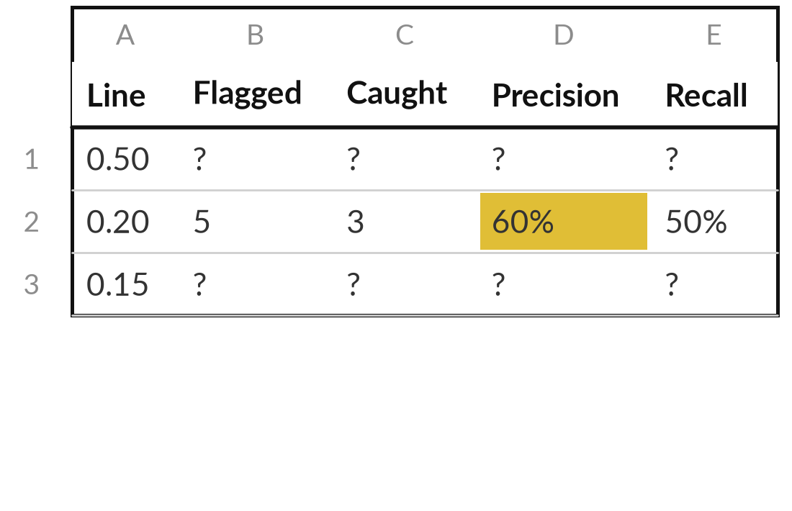
Move the line by hand: raise it
to 0.50, then lower it to 0.15
5 minutes
Hands-on, no computer
Redo the counts at two new thresholds.
Cross out your flags and flag again at 0.50.
Fill the first row of the small table.
Do the same at 0.15.
Say which line you would choose, and why.
You keep: Two rows of the table and one sentence.
Notes:
Now five minutes. Using the same twenty cases, change the threshold in your head. First raise the line to zero point five and recount. Fill in the first row of the small table. Then lower it to zero point fifteen and fill in the third row. The middle row, zero point two, is already done from your last exercise, so you can check yourself against it.
Look at what happens to precision and recall as the line moves. Then write one sentence saying which line you would choose for a late-payment model, and what it would cost you in false alarms or misses.

Slide 22





Six questions to put to any
vendor about the numbers
What data was it measured on? Had the model seen it?
How common is the case, and what does always saying no score?
What are precision and recall, at which threshold?
Who chose the threshold? What did each mistake cost?
How does it compare with a simple rule or today?
Can we test it on 50 of our own cases?
Notes:
This is the take-away. When a vendor says, our model is ninety-five percent accurate, you now have six questions. What data was that measured on, and had the model seen it?
How common is the thing you are looking for, and what would always saying no score?
What are precision and recall, and at which threshold?
Who chose the threshold, and what did each kind of mistake cost?
How does it compare with a simple rule or with how we do it today?
And can we test it on fifty of our own cases before we sign?
The full one-page sheet has four more, about monitoring, drift and who checks.

Slide 23


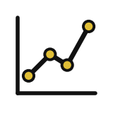

Which mistake would cost your
business more: a false alarm or a miss?
Think of the task you would most like a model to help with. Which mistake costs more?
A miss
A false alarm
About equal
I do not know yet
Set the line low. Accept more false alarms. Ask for recall.
Set the line high. Ask for precision.
Balance them. Ask for F1 and the threshold used.
Put a UGX figure on each mistake first.
Write the task, the costlier mistake and a first UGX figure for each in your workbook.
Notes:
Now bring it back to your own work. Think of one task you would like a model to help with: an alert, a shortlist, a sort. Ask yourself which mistake costs more, a false alarm or a miss. If a miss costs more, you want the line set low and you should ask the vendor for recall.
If a false alarm costs more, set it high and ask for precision. If they are about equal, ask for F1 and the threshold. And if you do not know, that is the finding: put a UGX figure on each mistake before you buy anything. Say your answer aloud to the group.

Slide 24
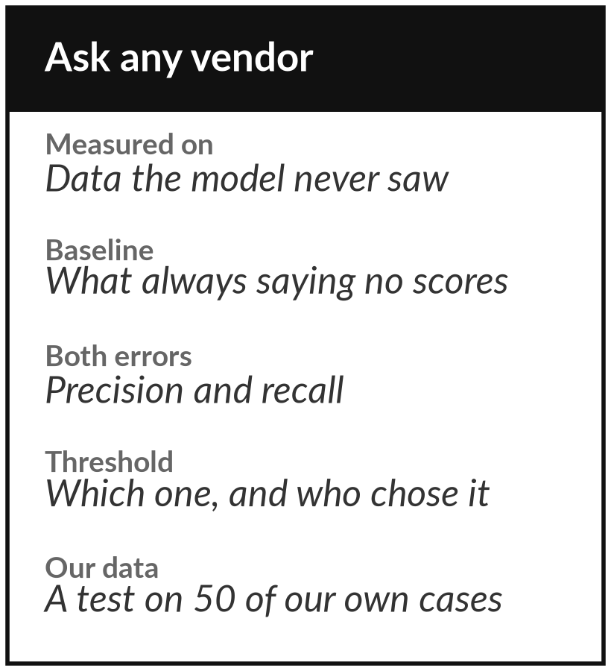
Keep the vendor question sheet, and
put it to the next proposal you read
What you keep from today
The vendor question sheet: ten questions about the numbers behind any AI claim. Keep it next to every proposal you read.
Our question today
How do I know whether a model is any good, and what should I ask the vendor who says it is?
Next session
Session 4: Words as numbers: bag of words, TF-IDF, embeddings and distance. Nothing to prepare.
Notes:
Keep the vendor question sheet. It is one page of ten questions about the numbers behind an AI claim. Put it next to the next proposal you read, and ask the questions before you ask about price. Session 4 starts a new topic, how a computer turns words into numbers, and you need to prepare nothing for it.
We began with this question: How do I know whether a model is any good, and what should I ask the vendor who says it is? Before you go, say in one sentence what you can now say about it.

